Slide 5
Evidence driven indoor air quality improvement
HORIZON-CL3-2021-FCT-01 - Indoor air pollution, an emerging threat recognized by European society, is claiming millions of lives annually.

Slide 6
Title Big One number 1

Slide 7
Title Big One number 2

Slide 8
Title Big One number 3

Slide 9
Title Big One number 4

Slide 10
Title Big One number 5

Slide 11
Title Info number one
1
2
3
Almost 66% of EU citizens read news online
Almost 70% of EU citizens goes online for info about products and services
>50% of EU citizens goes online to find health info
Veracity of info is often disputable
Sophisticated manipulation of content (e.g., deep fakes)
Untraceability of info (e.g., bots)
Distortion of public opinion
Radicalisation and violence, online and offline
Shift of attention and resources from concrete problems

Slide 12
Title Info number two
1
2
3
Almost 66% of EU citizens read news online
Almost 70% of EU citizens goes online for info about products and services
>50% of EU citizens goes online to find health info
Veracity of info is often disputable
Sophisticated manipulation of content (e.g., deep fakes)
Untraceability of info (e.g., bots)
Distortion of public opinion
Radicalisation and violence, online and offline
Shift of attention and resources from concrete problems

Slide 13
Title Info number three
Analyse
Support
FERMI will exploit a holistic and cross-disciplinary methodology towards a framework that will thoroughly analyse D&FN and their sources, in combination with all the socioeconomic factors that may affect both the
spreading of such incidents and their effects on multiple dimensions of society.
Comprising a set of innovative technological developments, FERMI will facilitate EU Police Authorities to detect and monitor the way that D&FN spread, both in terms of locations and within different segments of the society, and to put in place relevant security countermeasures.

Slide 14
Title Info number four
Analyse
Support
FERMI will exploit a holistic and cross-disciplinary methodology towards a framework that will thoroughly analyse D&FN and their sources, in combination with all the socioeconomic factors that may affect both the
spreading of such incidents and their effects on multiple dimensions of society.
Comprising a set of innovative technological developments, FERMI will facilitate EU Police Authorities to detect and monitor the way that D&FN spread, both in terms of locations and within different segments of the society, and to put in place relevant security countermeasures.

Slide 15
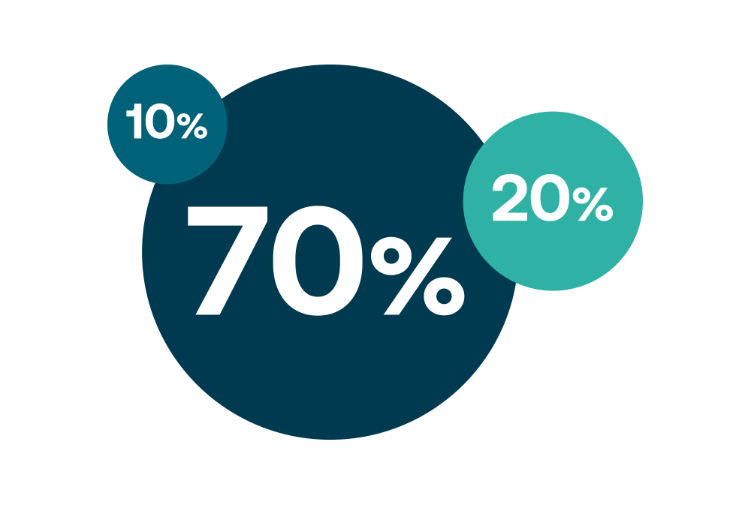
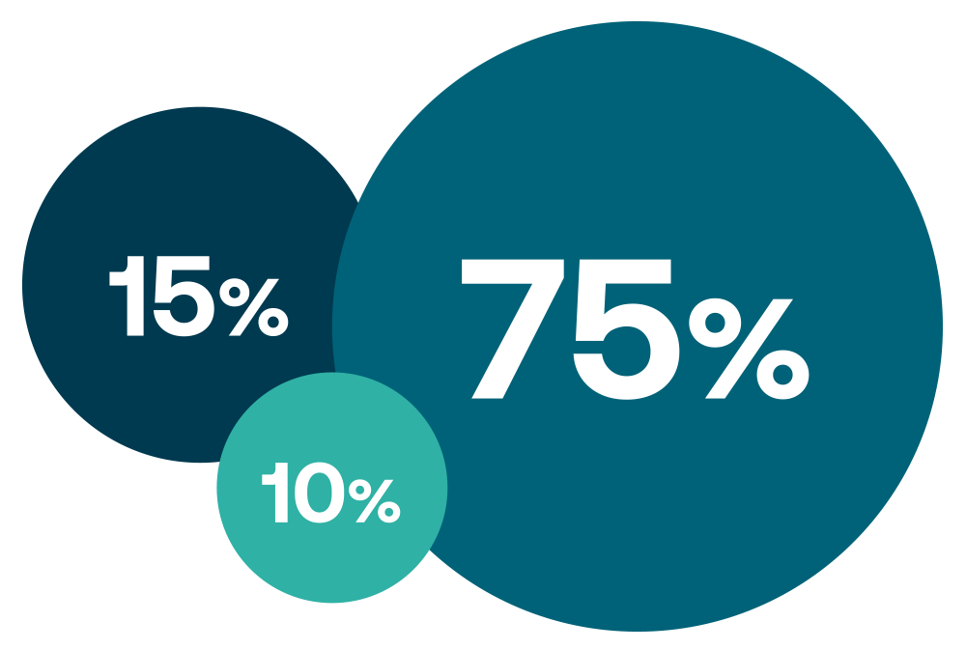
Title Info number five
Graphics 1
Predicting which kind of D&FN will lead to Predicting authors of those crimes
What are the environment and context where the criminal event will occur
Graphics 2
Predicting which kind of D&FN will lead to Predicting victims and targets
What are the environment and context where the criminal event will occur

Slide 16
Title Info number six
Analyse the direct risks posed by D&FN to the offline world and minimise the impact by
Predicting which kind of crimes D&FN will lead to
Predicting victims and targets of those crimes
Predicting authors of those crimes
What are the environment and context where the criminal event will occur

Slide 17
Title Info number six A
Analyse the direct risks posed by D&FN to the offline world and minimise the impact by
Predicting which kind of crimes D&FN will lead to
Predicting victims and targets of those crimes
Predicting authors of those crimes
What are the environment and context where the criminal event will occur
Design training and education material for European Police Authorities, other professionals and stakeholders, and EU citizens

Slide 18
Title Info number seven
Swarm Learning module: a decentralized machine-learning approach that unites edge computing, blockchain-based peer-to-peer networking and coordination while maintaining confidentiality without the need for a central coordinator, thereby going beyond federated learning.
Sentiment analysis module for fake news: Module for further analysis of fake news based on the BERT model (Bidirectional Encoder Representations from Transformers) with a wide variety of Natural Language Processing (NLP) tasks.
Crimes impact predictor: AI-based predictive tool forecasting spatiotemporal evolution of D&FN-induced and D&FN-enabled of offline crimes and producing bigdata-based profiling of authors and victims of D&FN-induced and D&FNenabled.
Disinformation sources and spread analyser: Set of tools for analysing in depth the sources of disinformation and the potential spread of the D&FN, as well as the potential impact of these spreads.

Slide 19
Title Info number eight
Crimes impact predictor: AI-based predictive tool forecasting spatiotemporal evolution of D&FN-induced and D&FN-enabled of offline crimes and producing bigdata- based profiling of authors and victims of D&FN-induced and D&FNenabled.
Behavioural profiler: Module integrating information from different sources for behavioural analysis and profiling .
FERMI disinformation watch: FERMI will create training material and deploy relevant sessions focusing on risk and threats analysis and the identification and implementation of cost-effective security measures

Slide 20
Title number nine
Crimes impact predictor: AI-based predictive tool forecasting spatiotemporal evolution of D&FN-induced and D&FN-enabled of offline crimes and producing bigdata- based profiling of authors and victims of D&FN-induced and D&FNenabled.
Behavioural profiler: Module integrating information from different sources for behavioural analysis and profiling .
FERMI disinformation watch: FERMI will create training material and deploy relevant sessions focusing on risk and threats analysis and the identification and implementation of cost-effective security measures

Slide 21
Title number ten
Swarm Learning module: a decentralized machine-learning approach that unites edge computing, blockchain-based peer-to-peer networking and coordination while maintaining confidentiality without the need for a central coordinator, thereby going beyond federated learning.
Sentiment analysis module for fake news: Module for further analysis of fake news based on the BERT model (Bidirectional Encoder Representations from Transformers) with a wide variety of Natural Language Processing (NLP) tasks.

Slide 22
Title number eleven
Swarm Learning module: a decentralized machine-learning approach that unites edge computing, blockchain-based peer-to-peer networking and coordination while maintaining confidentiality without the need for a central coordinator, thereby going beyond federated learning.
Sentiment analysis module for fake news: Module for further analysis of fake news based on the BERT model (Bidirectional Encoder Representations from Transformers) with a wide variety of Natural Language Processing (NLP) tasks.

Slide 23
Title number twelve
Swarm Learning module: a decentralized machine-learning approach that unites edge computing, blockchain-based peer-to-peer networking and coordination while maintaining confidentiality without the need for a central coordinator, thereby going beyond federated learning.
Sentiment analysis module for fake news: Module for further analysis of fake news based on the BERT model (Bidirectional Encoder Representations from Transformers) with a wide variety of Natural Language Processing (NLP) tasks.

Slide 24
Many Thanks
This is the Closing Page

